Slide 1
Food Demand Analysis
File created on: 6/28/2022 12:29:36 PM
By Nekender Shekahwat

Slide 2
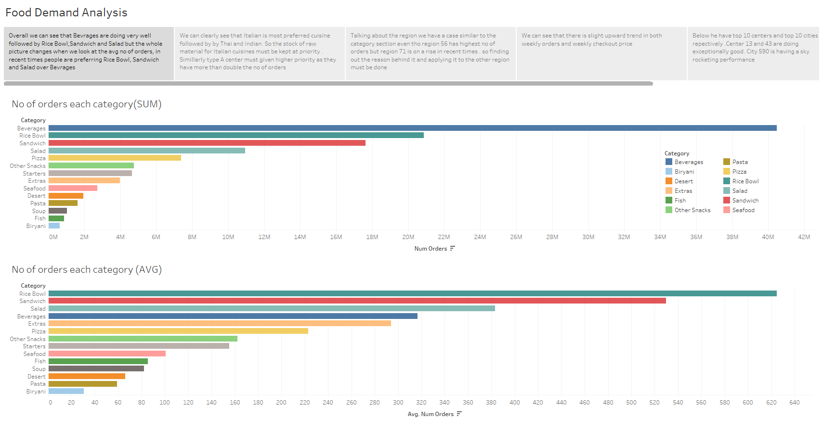

Slide 3
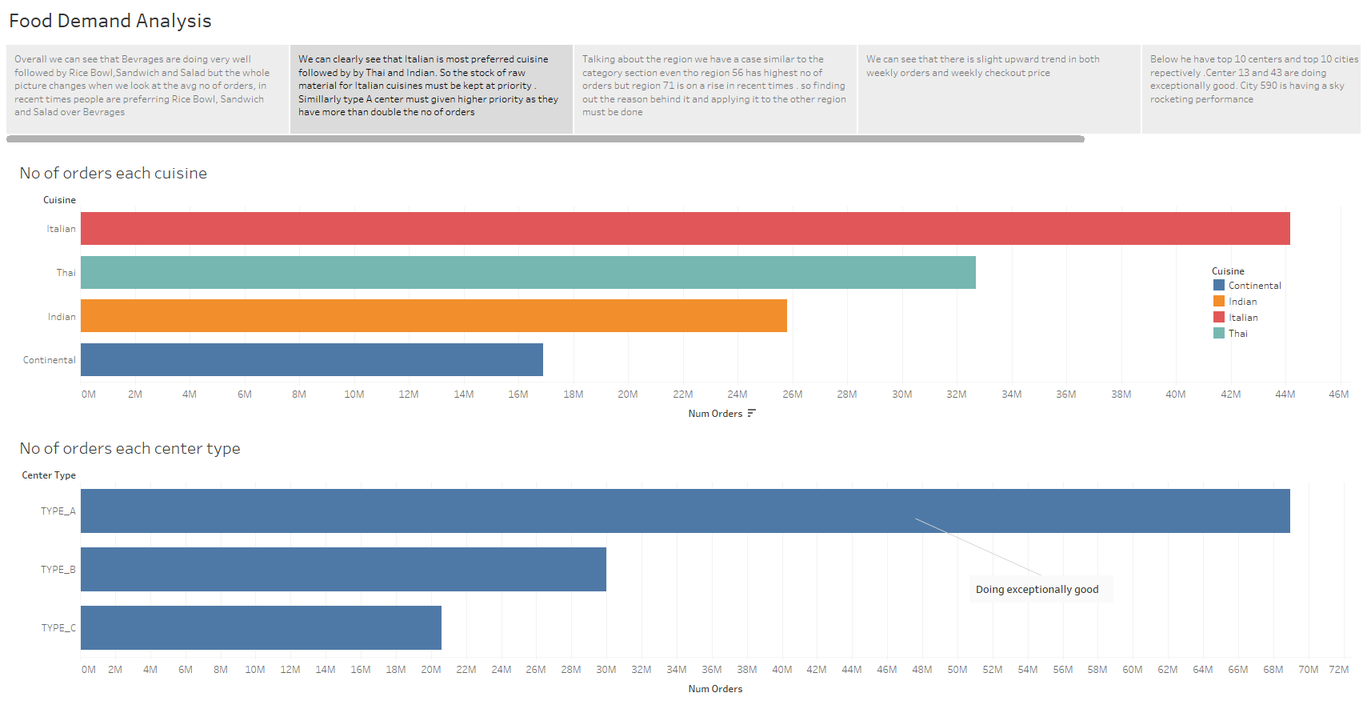

Slide 4
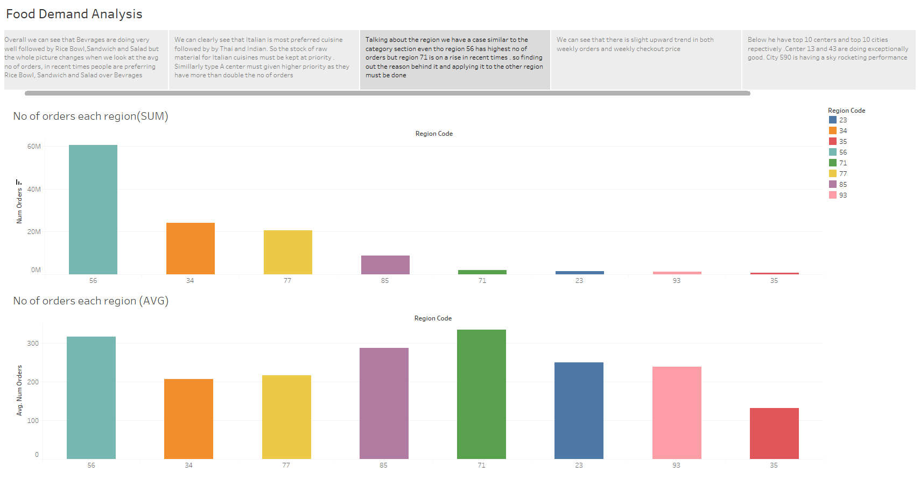

Slide 5
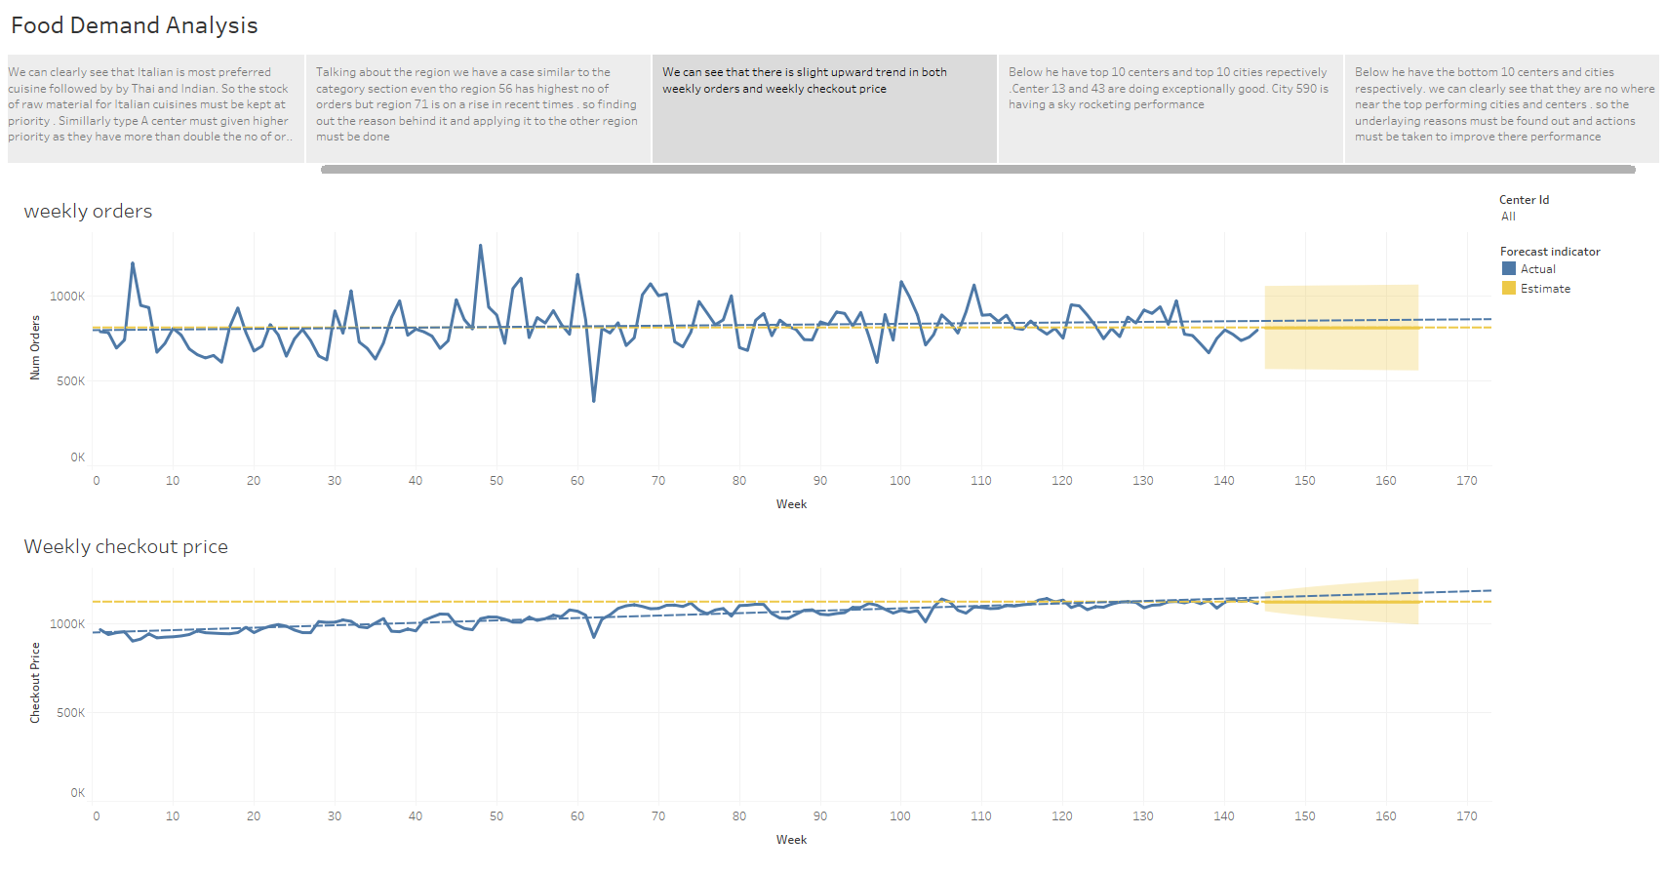

Slide 6
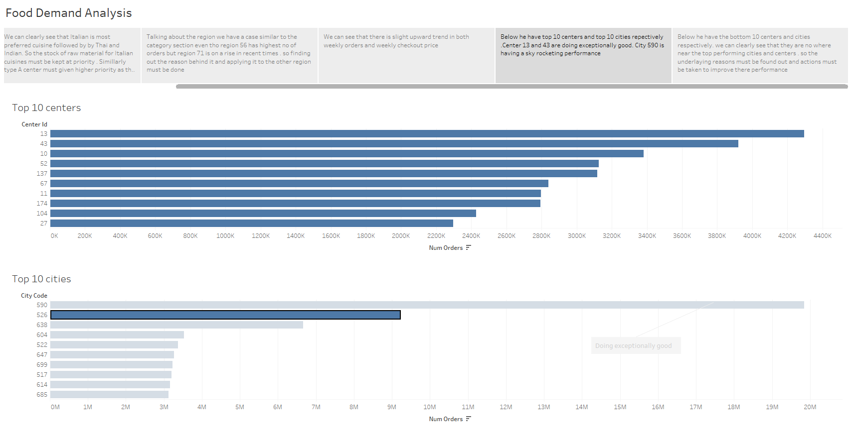

Slide 7
